Slide 1
RoboHub Equipment Specific Training: Vicon
Waterloo RoboHub Faculty of Engineering

Slide 2
Equipment Specific Training
After completing this module, you can contact the manager of the RoboHub to book your in-person equipment specific training.
The in-person training session involves a review of your ability to correctly and safely set-up and use the system for your purposes.
You will then be able to book time slots to use the Vicon system on the RoboHub Clustermarket calendar.
* This training module provides links to tutorial videos created by Vicon. Although times are provided to show the basic information, you may wish to watch videos in their entirety depending on your research needs. *

Slide 3
Introduction to vicon in the robohub

Slide 4
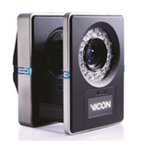
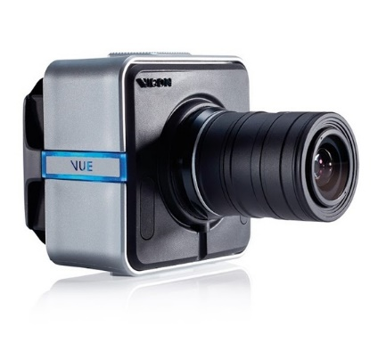
Vicon Equipment
Equipment |  | Function | Location
Vantage Cameras |  | Optical cameras that record marker position in 3D space. | Twelve (12) permanently mounted on wall rails and ceiling, surrounding the RoboHub Central Zone. Four (4) in grey storage cabinet on South wall of the lab, able to be tripod mounted.
Vue Cameras |  | Cameras that capture video footage and allow for marker trajectory overlay. | Two (2) in the grey storage cabinet on South wall of the lab able to be tripod mounted.
[1]
[2]

Slide 5
Vicon Overview
Vicon is a passive marker-based motion capture system created by Vicon Motion Systems Ltd.
Vicon uses retroreflective markers to reflect infrared light, emitted from nearby cameras, back to the camera lens to record 3D marker position in space.
RoboHub is equipped with both Tracker and Nexus software to view, edit, and process the captured data.
Tracker is best used for object-tracking of rigid bodies; while Nexus can be used for kinematics and movement analysis.

Slide 6
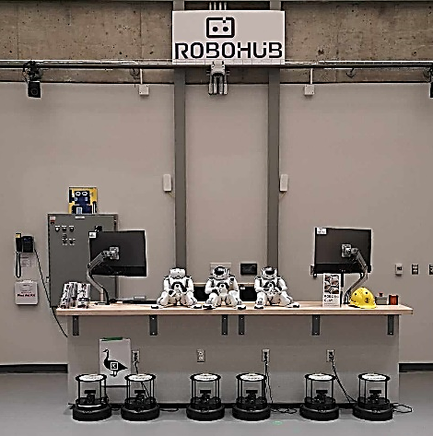
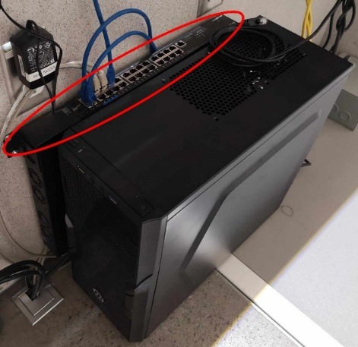
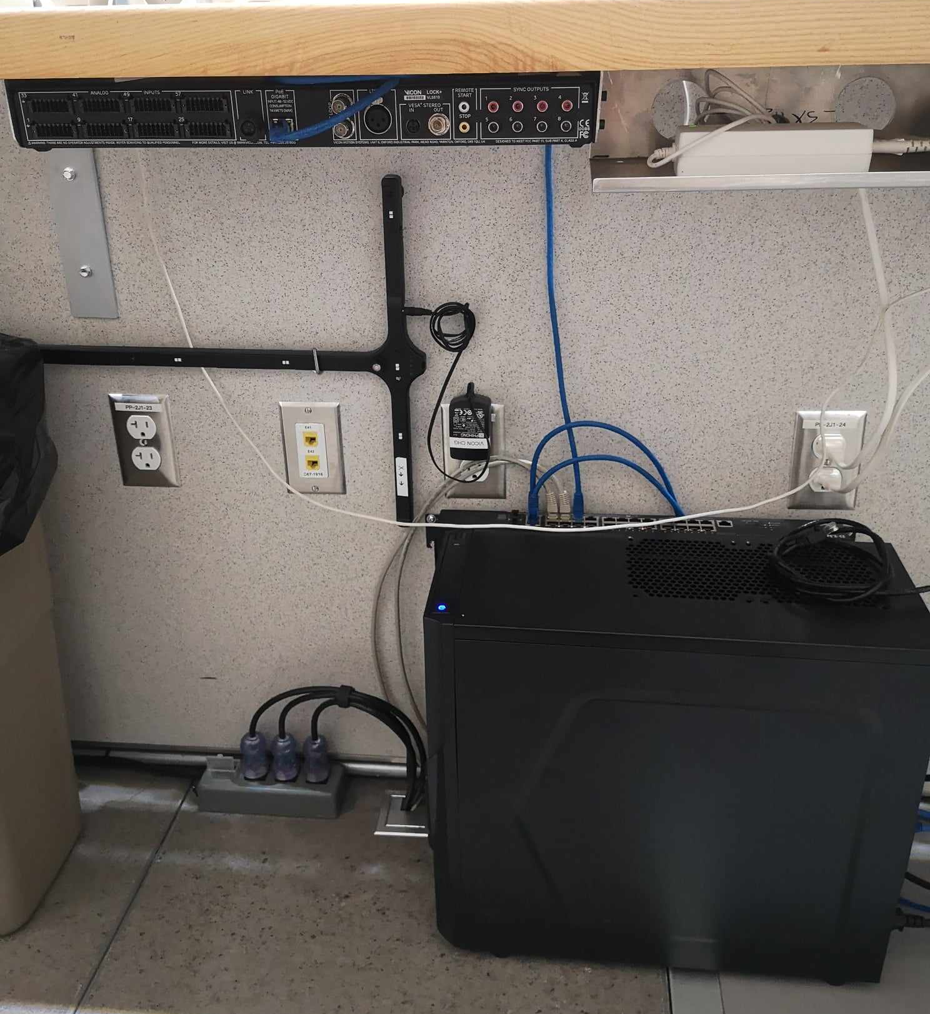
Vicon Equipment
Equipment |  | Function | Location
Vicon Podium Computer |  | Computer with Vicon software to view, edit, and process data. | On/under the podium.
Vicon D-Link |  | D-Link router to connect Vantage and Vue cameras. | Mounted between the computer and podium wall.
Vicon Lock+ |  | Vicon control box to connect 3rd party devices. | Mounted underneath the podium tabletop.

Slide 7
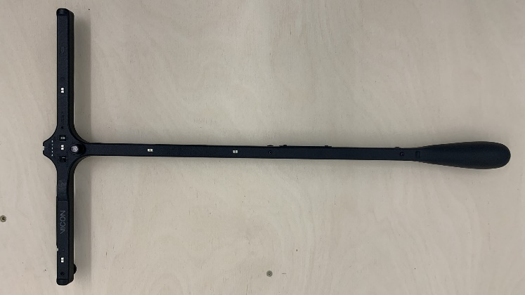
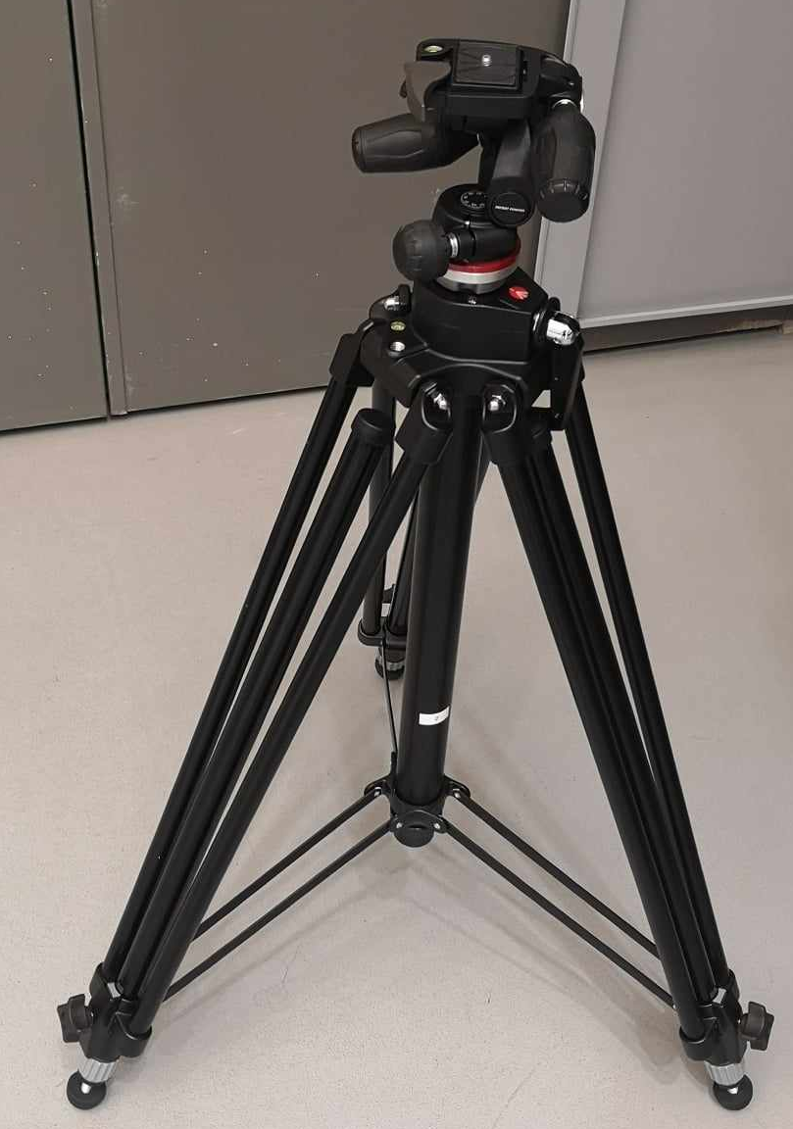
Vicon Equipment
Equipment |  | Function | Location
Active Calibration Wand |  | Wand used to calibrate Vantage and Vue cameras. | Hanging on hooks mounted on the inside wall of the podium.
Tripods |  | Tripods to mount the Vue cameras for collections. | Grey storage cabinet on South wall of the RoboHub lab.
[3]

Slide 8
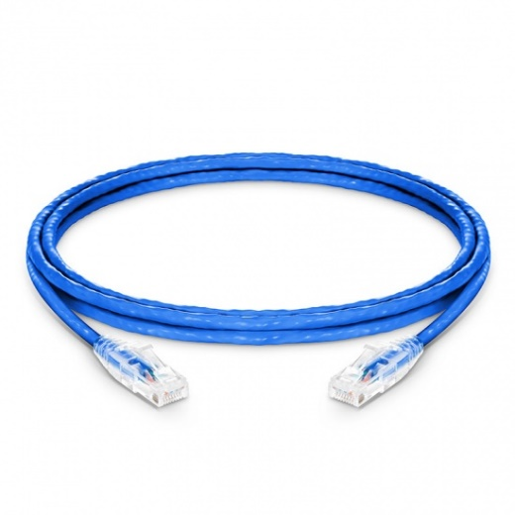
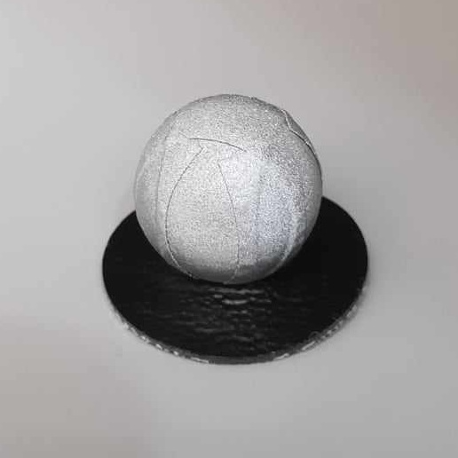
Vicon Equipment
Equipment |  | Function | Location
Cat6 Cables |  | Cables for connecting Vue cameras to the D-Link. | Grey storage cabinet on South wall of the RoboHub lab.
Vicon Motion Capture Markers |  | Passive markers that reflect light back to the Vicon cameras to track 3D position of markers. | Grey storage cabinet on South wall of the RoboHub lab.

Slide 9
Vicon Rules and Guidelines
Never leave the cameras running for longer than 24 hours
Under normal operation in elevated ambient conditions, the Vue camera’s heat sink temperature can exceed 56ºC. During and directly after camera operation, do not touch the heat sink.
Be aware of all hazards associated with the individual equipment that is being captured with the Vicon system.
When using Vue cameras ensure all cords and tripods are located where tripping hazards are minimized.
Comply with UW guidelines for PPE when performing experiments.
Return all items used back to grey cabinet in a neat, orderly manner.

Slide 10
Hardware Set-up

Slide 11
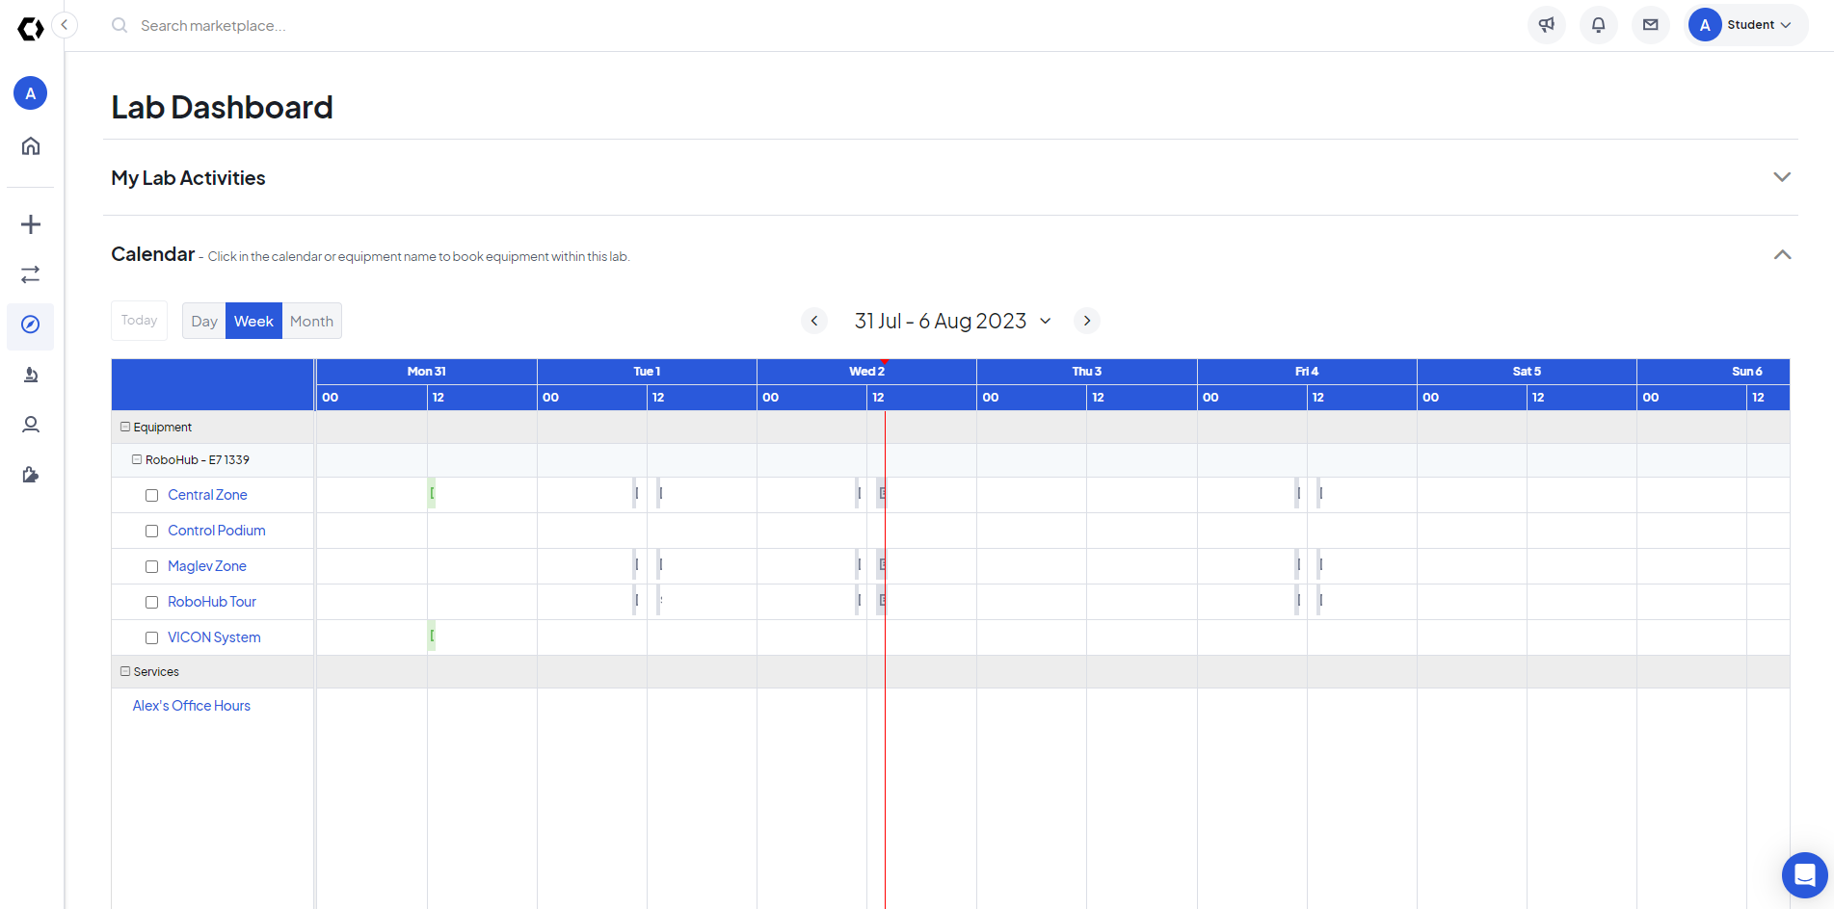
Pre-Start Checklist
Verify that you have booked the necessary lab space and camera system on the Robohub Clustermarket calendar.
When collecting data with the Vicon system that requires the open space in the Robohub lab ensure that the Vicon System, the Control Podium, the Central Zone, and the Maglev Zone are all booked.
If only the Vicon software is needed, ensure the Vicon system and the Control Podium are booked.
Ensure that all materials needed for collections are available and present before beginning Start-up Procedure.
This could include, but is not limited to, robots, Vicon motion capture markers, adhesive tape, the Vicon calibration wand, etc.

Slide 12
Start-Up Procedure
Turn on the Vicon computer and login.
Turn on red power bar switch located on the floor underneath the podium a minimum of 30 minutes prior to beginning data collection.
The indicator lights on the front faces of the Vantage cameras will turn BLUE a few moments after the switch is turned on and all Vicon hardware will be visible in the ‘Systems Resource’ pane in the Vicon software.
If you are using the Vue video cameras (which integrate with Nexus only) follow the set-up instructions on the following slide.

Slide 13
Using Vue Cameras
Unpack the tripods and Vue cameras from the grey storage cabinet located on the South wall of the lab.
Set the tripods to the desired height, ensuring you can reach the top of the tripod.
Unpack the Vue cameras from the boxes and remove the camera lenses.
Screw the Vue cameras onto the tripod using the threaded hole on the bottom side of the camera.
Plug in a Cat6 cable from the Vue camera(s) to the D-Link router mounted on the inside wall of the podium, underneath the podium computer.

Slide 14
IMPORTANT: Leave cameras on for at least 30 minutes before data collection begins. If possible, leaving the cameras on for 30 to 90 minutes is preferable.

Slide 15
Vicon Software
Ensure all hardware you want as part of the system is turned on.
Open the desired Vicon program (either Vicon Nexus or Tracker).
Tracker
Nexus
Rigid body motion tracking
Applications in engineering, robotics, human factors
Watch the Vicon tutorial video: Introduction to Vicon Tracker
Rigid body motion tracking
Motion analysis
Applications in engineering, biomechanics, kinematics
Watch the Vicon Nexus Introduction videos: Introducing Nexus and General Workflow for Capture.

Slide 16
System Preparation

Slide 17
System Preparation – Data Storage
Tracker
Nexus
In Tracker, the data storage file path is pre-set and can remain the same for all collections.
In Nexus, you must use an existing database or create a new database to calibrate the system and collect data.
Watch the Vicon tutorial video on creating and managing databases in proEclipse from 0:00-4:26.
All data is to be stored in the Data Drive.
It is recommended that if there is an existing database for your lab, create a ‘New Patient Classification’ within this database for a new study.
If a database for your lab does not exist create a new one, setting the name as your lab group name.

Slide 18
System Preparation – Calibration
After letting the cameras warm up for at least 30 minutes and selected the appropriate Vicon software you can begin calibrating the system for collection.
The cameras (including the Vue cameras if using Nexus) need to be calibrated with respect to each other and with respect to the room.
Calibration is required every day or after long periods of inactivity during the same day.
Before calibrating ensure that the lab space you require is empty and no person or robot is moving through the space.

Slide 19
If Using Vue Cameras
Open Vicon Nexus on the podium computer.
Left click the Vue camera device you want to view in the ‘Resource’ pane.
In the ‘Data Viewing’ pane select ‘Camera View’ from the drop-down menu in the top left corner of the pane.
You should see video camera footage of the room. If the screen is black, it is likely the wrong IP address is being used. Change the IP address in the ‘Properties’ section in the ‘Resource’ pane.
Once camera footage is visible, use the metal knobs on the camera lens to adjust the aperture, focal length, and magnification of the camera lens.
The knobs are fixed in place by spinning the knob clockwise and unfixed by spinning counter-clockwise. To change the settings, unscrew the knobs, ONLY until the sliding scales can glide easily around the circumference of the lens.
When the camera picture comes into focus on the computer monitor you can tighten the knobs gently, until the sliders no longer move easily.

Slide 20
Data Capture

Slide 21
System Preparation – Calibration
Tracker
Nexus
The calibration procedures for Tracker and Nexus are similar.
Watch the Nexus Calibration video from 0:00 – 3:39 for Vue camera calibration and from 12:42 – 14:07 for setting the floor plane (done after setting the volume origin).
Watch the following video showing the Tracker Calibration process.
Cameras have already been Aimed and Focused on the capture volume.
For most use cases cameras can be set to 100Hz. When required, Vantage cameras sampling frequency can be changed in ‘Properties’.

Slide 22
Subject Preparation
Once the system is calibrated the next step is preparing the subject for collection; whether it is a rigid object, a robot, or a person.
These steps will vary depending on system use, but in the Vicon system, to capture any data, the subject must be fitted with the Vicon passive motion capture markers.
Adhesives used for attaching the markers can be found in the grey storage cabinet located on the South wall of the RoboHub lab.

Slide 23
Creating Models
Tracker
Nexus
In Tracker, rigid body templates, called objects, are created and snap to markers in the capture volume.
Watch the following Tracker tutorial video explaining how to create objects, collect data, and playback collections.
Nexus model creation involves creating a labelling template (VST) and then calibrating that template.
Nexus allows you to use built-in labelling templates or to create custom labelling templates.
Watch the tutorial videos for basics on building (0:00-10:15) and using a custom VST.
More information on existing labelling templates can be found in the Nexus tutorial videos and on the Vicon website.

Slide 24
Data Capture
Tracker
Nexus
Tracker data capture is included in the tutorial video on the previous slide.
Watch the data capture tutorial video from time 1:10 - 4:33 and 12:05 - 13:13 on how to capture a collection.
Watch the entire video for an explanation of every section in the data capture tab and how they allow for customization of your collection methods.

Slide 25
Post-Processing
Tracker
Nexus
Viewing captured data in Tracker is included in the tutorial video on the previous slide.
The following tutorial video outlines the general workflow for post-processing from 0:00-3:34 and from 8:30-10:15.
Post-processing in Nexus can vary depending on your needs. For brevity, this training will direct you to the Vicon YouTube tutorial playlist for more in-depth post-processing information.

Slide 26
Data Export

Slide 27
Data Streaming and Export
Tracker
Nexus
Tracker data can be streamed directly to 3rd party applications via the Vicon DataStream SDK.
The Datastream tutorial video shows how to access this data via Matlab, C++, and VRPN.
Tracker data can also be streamed to ROS using available packages such as Vicon Bridge.
Data from Nexus can also be streamed live or in post-processing via the methods mentioned on the left.
Additionally, File Export tools are available in the Tools Pane under the Pipeline tab > File Export.
E.g., Marker trajectories and kinematic data can be exported using the Export ASCII pipeline.
More information on streaming and exporting data can be found on the Vicon website.

Slide 28
Resources
Documentation
Vicon Tutorial Videos
Vicon Website
Tracker Documentation
Nexus Documentation
Vicon FAQ Section
Tracker Tutorial Videos
Nexus Tutorial Videos

Slide 29


